Slide 1
Big Data-Powered Sentiment Analysis for
Code-Mixed Hindi-English Tweets
Team Name: Big Data Enthusiasts Team Members:
Asmita Sonavane (as20428)
Vishwajeet Kulkarni (vk2630)
Sarang P. Kadakia (Team Lead) (sk11634)

Slide 2
P A R T 0 1
February – Dataset Collection & Planning
- Selected AI4Bharat Code-Mixed Tweet Dataset - Finalized pipeline architecture and toolset - Defined project scope, objectives, and evaluation metrics
March – Data Storage & Processing Pipeline
- Stored tweets using Apache HBase - Implemented Spark NLP for tokenization, normalization, and transliteration - Used PySpark MLlib for dataframe transformation and TF-IDF feature extraction
April – Modeling & Retrieval
- Fine-tuned IndicBERT for multilingual sentiment classification - Validated using sample predictions and domain-level performance
May – Evaluation, Storage & Finalization
- Evaluated models for Accuracy, F1-Score, Class Proportion - Integrated a clean, structured output storage - Visualized insights (domain trends, frequent terms, sentiment distribution) - Finalized presentation, report, and code repository

Slide 3
Problem Statement
Hindi-English code-mixed tweets are difficult to analyze using traditional NLP tools due to:
Frequent language switching within a single sentence.
Inconsistent transliteration of Hindi into Roman script.
Non-standard spellings and informal structures.
Motivation
Social media platforms like Twitter are rich in public opinion, especially in multilingual regions like India.
Code-mixed content reflects authentic user emotion, yet lacks reliable tools for large-scale analysis.
A Big Data-powered solution is essential to process high-volume, noisy, and linguistically diverse tweets.
P A R T 0 2

Slide 4
Project Objectives:
- Scalable preprocessing pipeline for code-mixed tweets
- Sentiment classification via IndicBERT.
- Use Big Data frameworks (HDFS, HBase, Spark NLP, PySpark) for scalable processing
- Evaluation with Accuracy and F-1 Score to ensure multilingual model robustness
P A R T 0 3

Slide 5
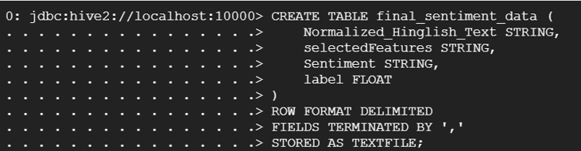
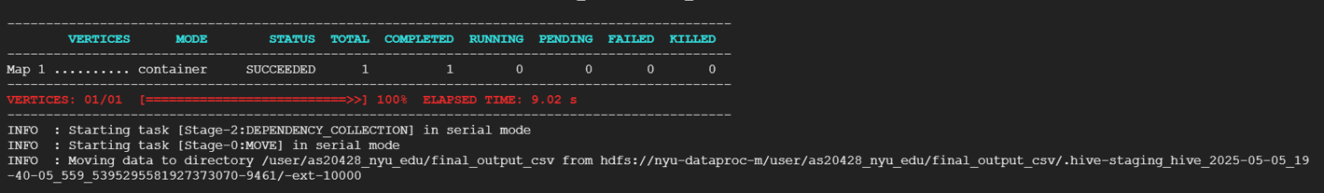
Dataset Overview
Dataset Source: AI4Bharat Mann ki Baat [1,00,000+ tweets across politics, sports, culture, and more with mixed-language structure.
Hive - It integrated to enable structured,
scalable querying of the processed data
for ensuring seamless access for analysis
and future extensions.
P A R T 0 4

Slide 6
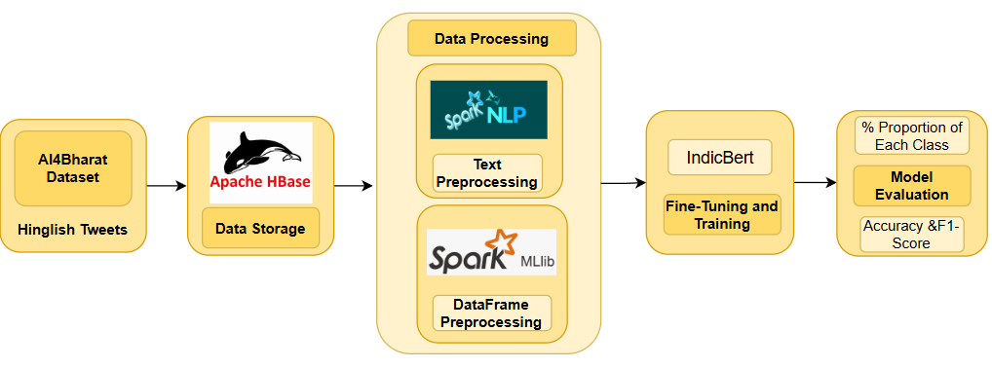
P A R T 0 5
System Architecture & Flow Diagram

Slide 7
Data Cleaning & Preprocessing (using Spark MLlib):
- Loaded raw English–Hinglish CSV with inferred schema. - Dropped unnecessary columns ("Column3", "Column4") and spurious rows ("en_query", "csquery"). - Removed duplicates, reducing dataset size from ~140K to ~130K rows. - Saved cleaned data as cleaned_output_stage1.csv for downstream tasks
P A R T 0 7

Slide 8
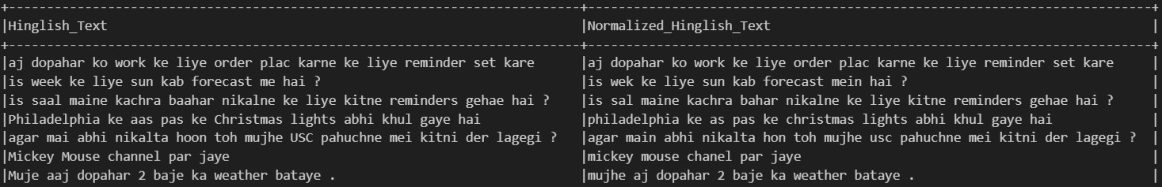
Text Preprocessing (PySpark NLP):
- Applied Ekphrasis for social-media token correction and standardization for English instances. - Built custom Hinglish normalization dictionary for common spelling errors. - Hybrid normalization pipeline: DocumentAssembler → Tokenizer → UDF-based corrections - Generated Normalized_Hinglish_Text field ready for feature engineering
P A R T 0 8

Slide 9
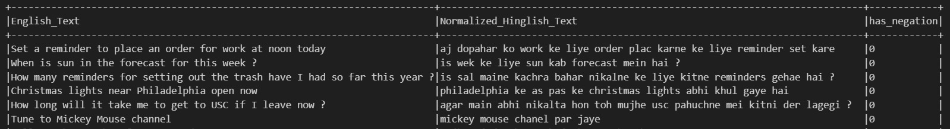
Negation Detection:
- Curated a comprehensive English + Hindi negation word list manually - Built a regex pattern to detect presence of negation in the text - Created binary feature has_negation to enrich downstream sentiment modeling
P A R T 0 9

Slide 10
Part-of-Speech Tagging:
- Evaluated three Spark NLP POS models: pos_hiencs, pos_anc, pos_hdtb - Used manually annotated ground-truth labels for accuracy validation - Selected pos_anc model (best performer) after comparison via accuracy plots - Added pos_tags column capturing token-level linguistic information
P A R T 1 0

Slide 11
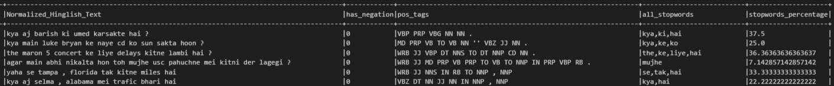
Stopword Extraction:
- Applied Spark NLP StopWordsCleaner for English and Hindi stopword removal - Used manually annotated ground-truth labels for accuracy validation - Selected pos_anc model (best performer) after comparison via accuracy plots - Added pos_tags column capturing token-level linguistic information
P A R T 1 1

Slide 12
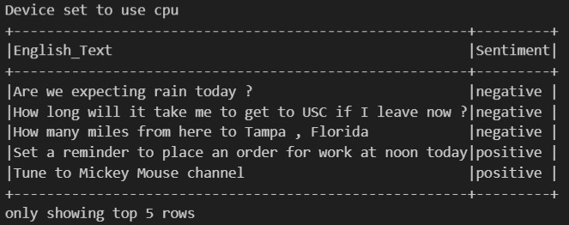
Sentiment Labeling:
- Used Hugging Face DistilBERT SST-2 model to auto-label English text sentiment - Predicted sentiments in small batches (batch size = 32) to avoid memory issues - Merged generated sentiment labels into the Spark DataFrame, creating Sentiment column
P A R T 1 2

Slide 13

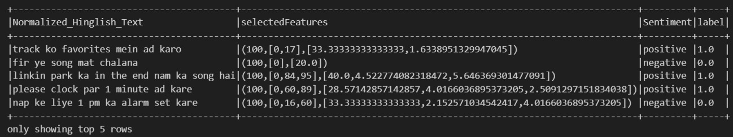
Feature Selection & Importance Tracking:
- Tokenized Normalized_Hinglish_Text and applied HashingTF (5K features) followed by IDF weighting - Assembled TF-IDF features + numeric features (stopwords_percentage and has_negation) using RandomForestClassifier
- Applied ChiSqSelector to pick top 100 most important features for training
P A R T 1 3

Slide 14
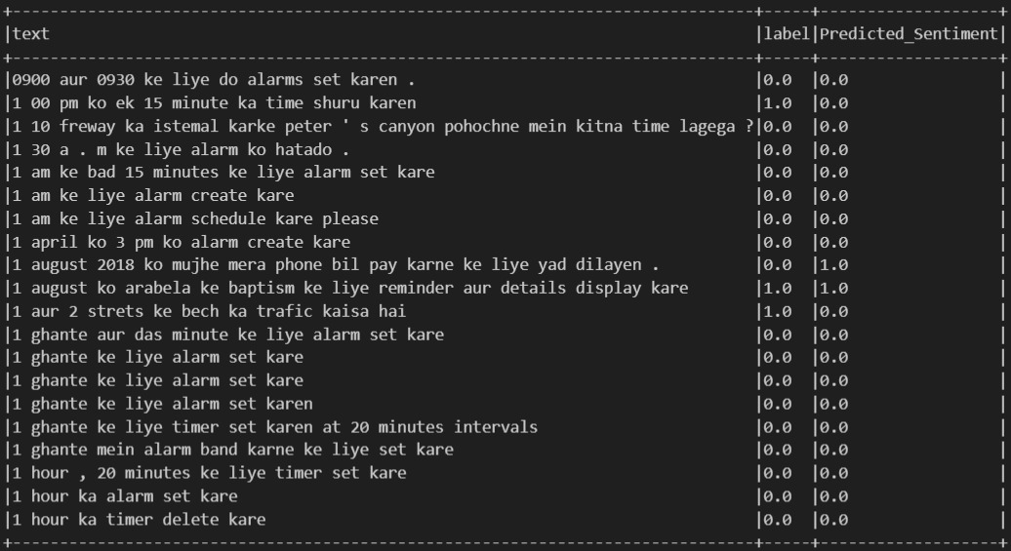
Model Training:
- Built Spark NLP training pipeline: DocumentAssembler → Tokenizer → IndicBERT (Albert Embeddings) → SentenceEmbeddings → ClassifierDL - Trained model on 70% training split using GPU acceleration, with batch size 64 and 50 epochs - Logged training metrics and saved the trained IndicBERT model for inference from Spark NLP (Jon Snow labs) and not from Hugging Face
P A R T 1 4

Slide 15
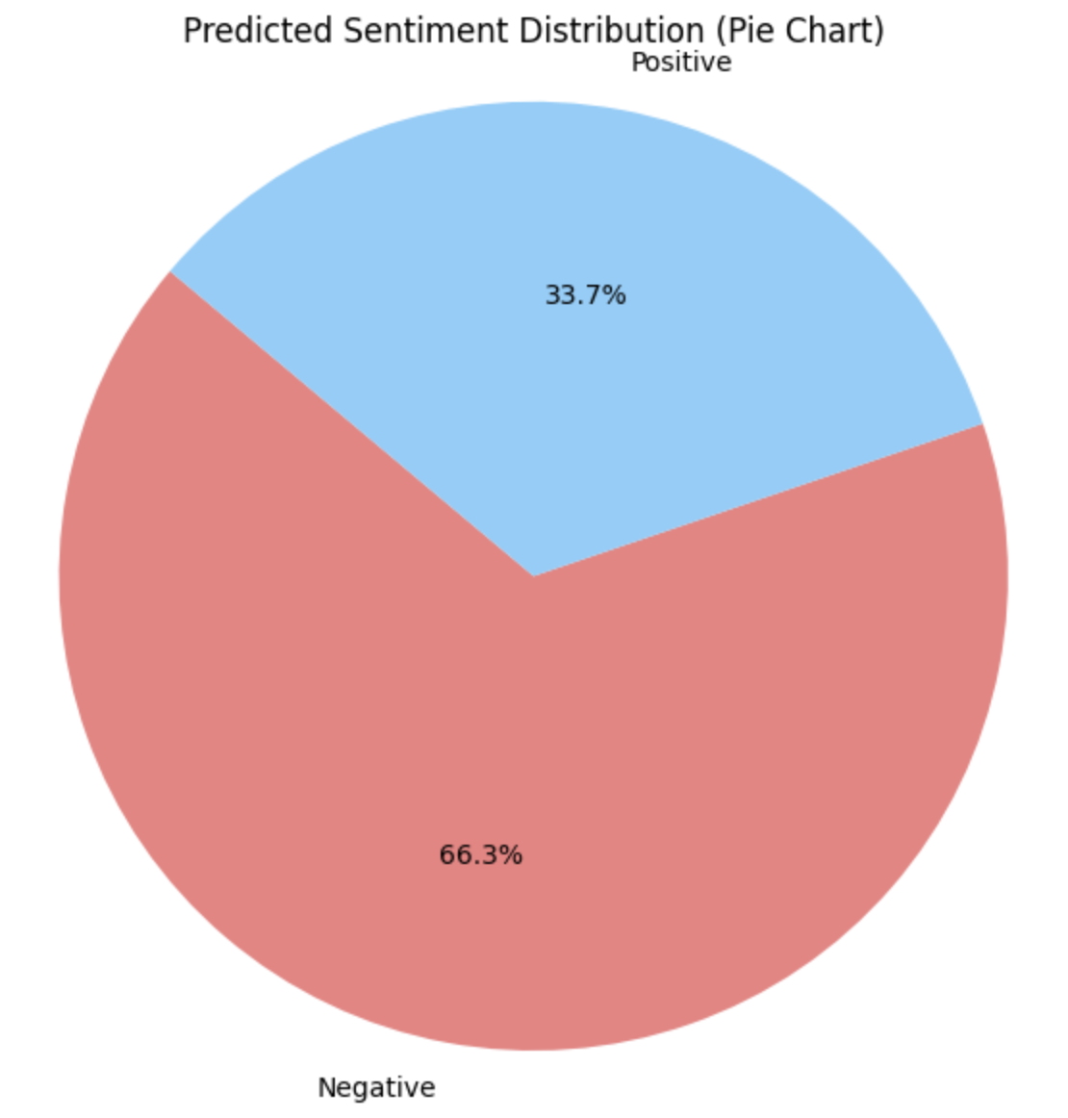
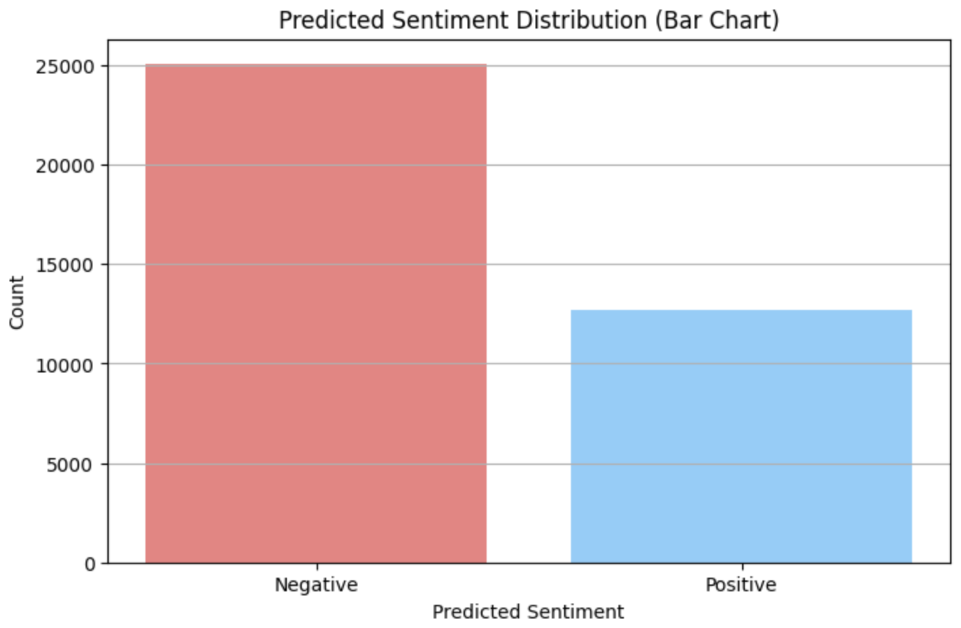
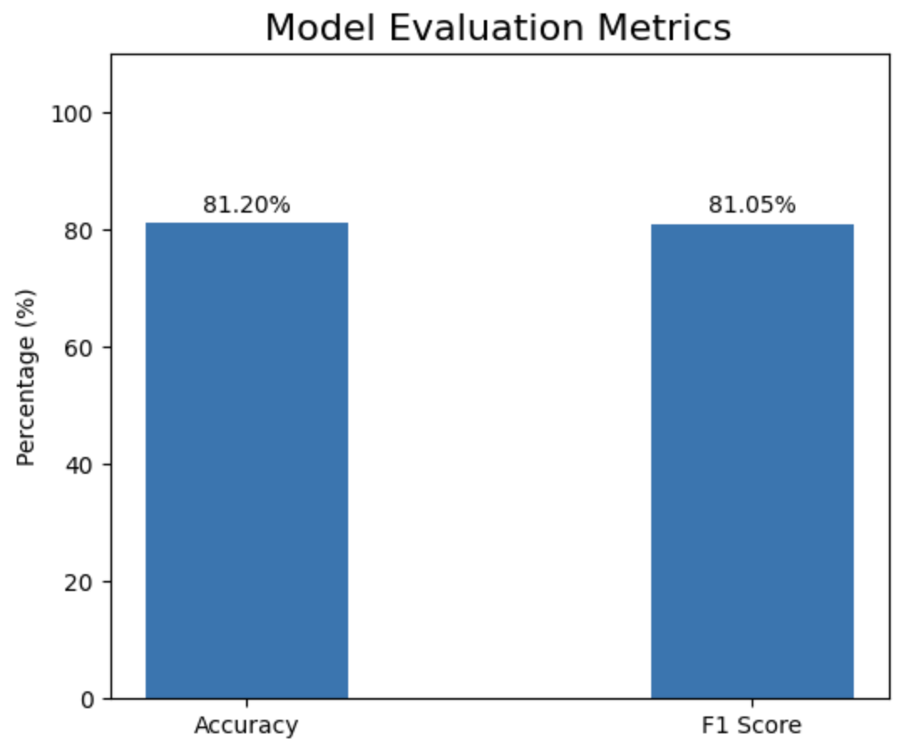
Evaluation & Results:
- Loaded the saved model and performed inference on 30% test split - Achieved Accuracy: 81.20% and Weighted F1 Score: 81.05% on unseen data - Visualized results with metric bar charts and class distribution
P A R T 1 5

Slide 16
Conclusion:
- Developed an end-to-end scalable Hinglish sentiment analysis pipeline using Spark NLP and PySpark. - Seamlessly integrated text normalization, feature engineering, and deep learning modeling. Future Scope:
- Extend to more Indian languages like Tamil and Bengali.
- Integrate Facebook/Instagram datasets for domain expansion.
- Trend Detection and building real-time trend dashboards using Hive and Spark Streaming.
P A R T 1 6

Slide 17
Thank You!!

